Slide 1

Inventory Tracker
THANH NGUYEN

Slide 2
What Caused the Motive?
Volunteer at my parent’s shop
Problem Tracking Inventory
SQL or Raspberry Pi

Slide 3
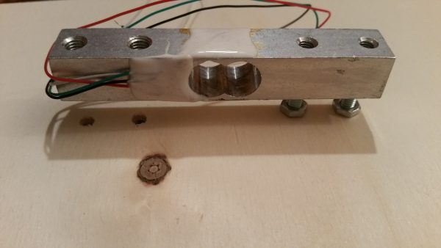
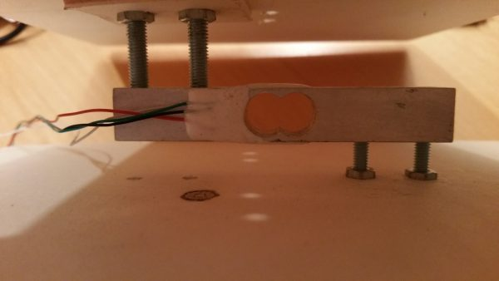
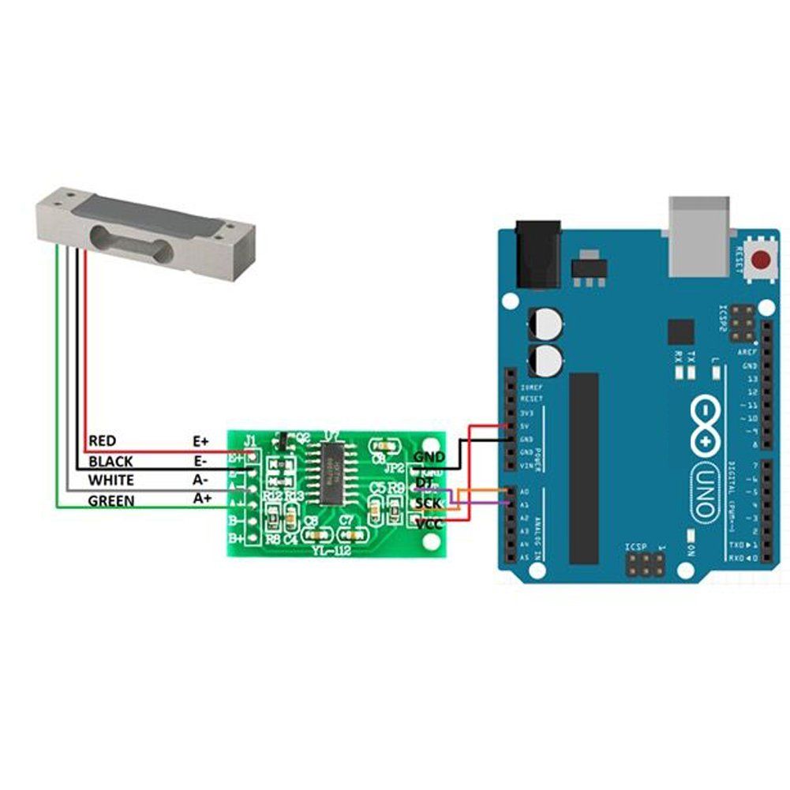
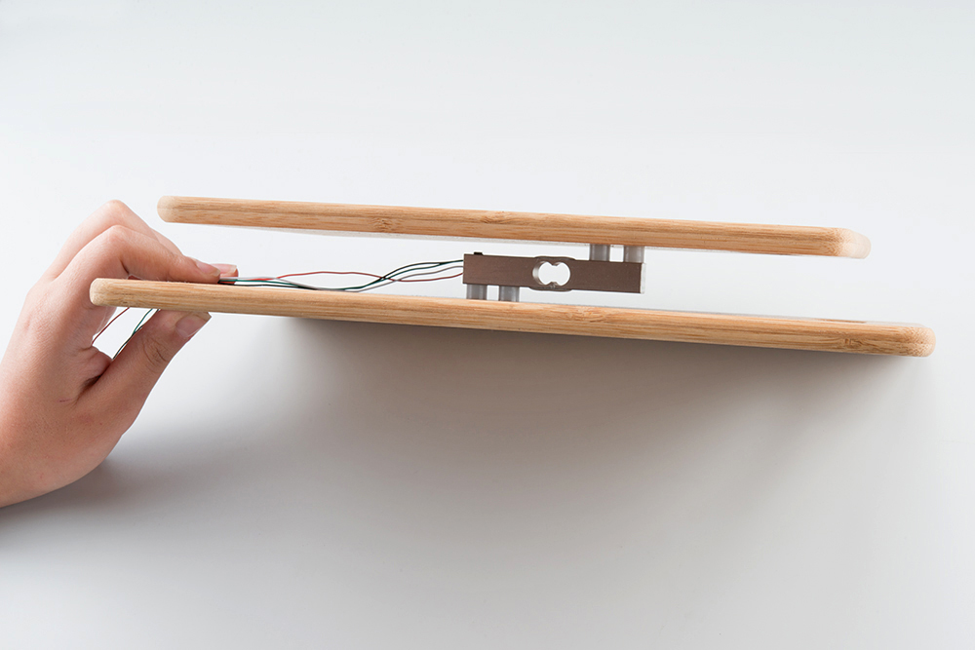
Initial Research
Raspberry Pi
Load Cell
HX711 Load Cell AmP/ Weight sensor
ATmega328P
Breadboard
Jumper Wires
Two Boards
Or Use FSR

Slide 4
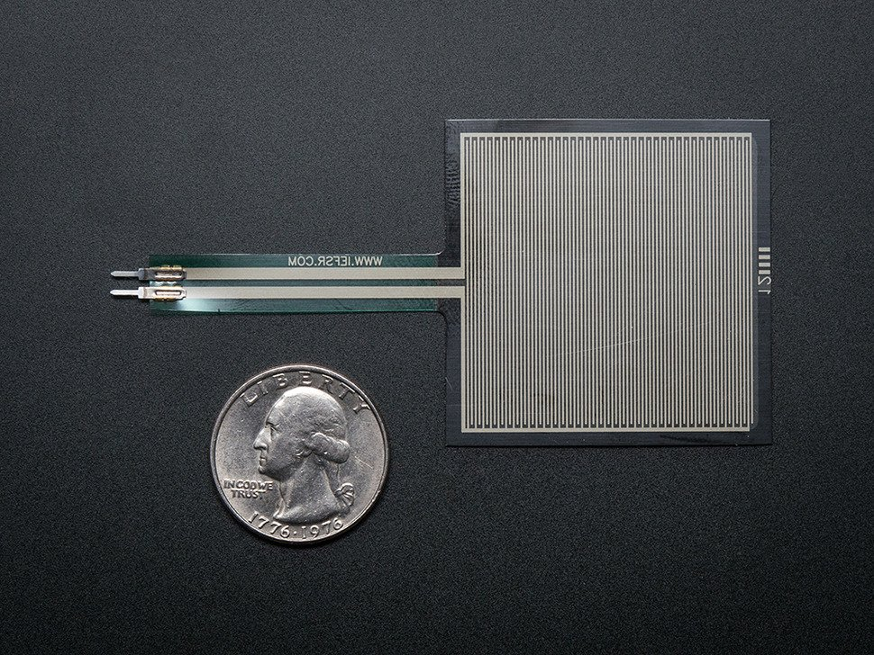
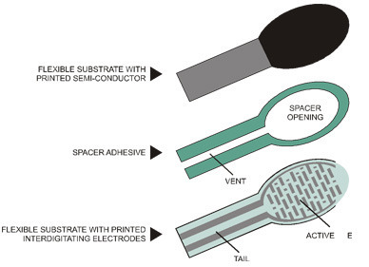
FSRs
Sensors that detect Physical Pressure, Squeezing and Weight
It’s only Two layers separated by a spacer
Simple and low cost
Vout = Vcc x R / (R + Rfsr)
It Uses Resistive values Measured in OHMs but…
Notes:
described it like a button
But it isn’t that accurate

Slide 5
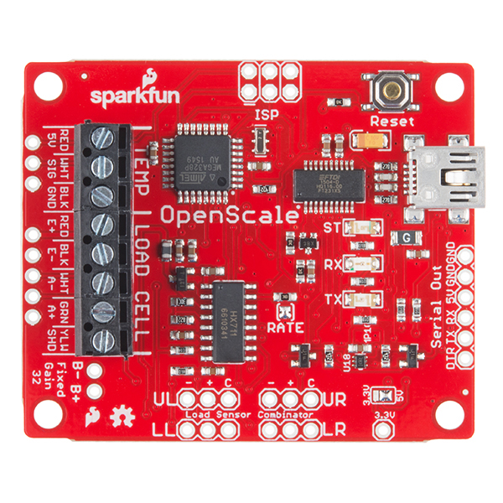
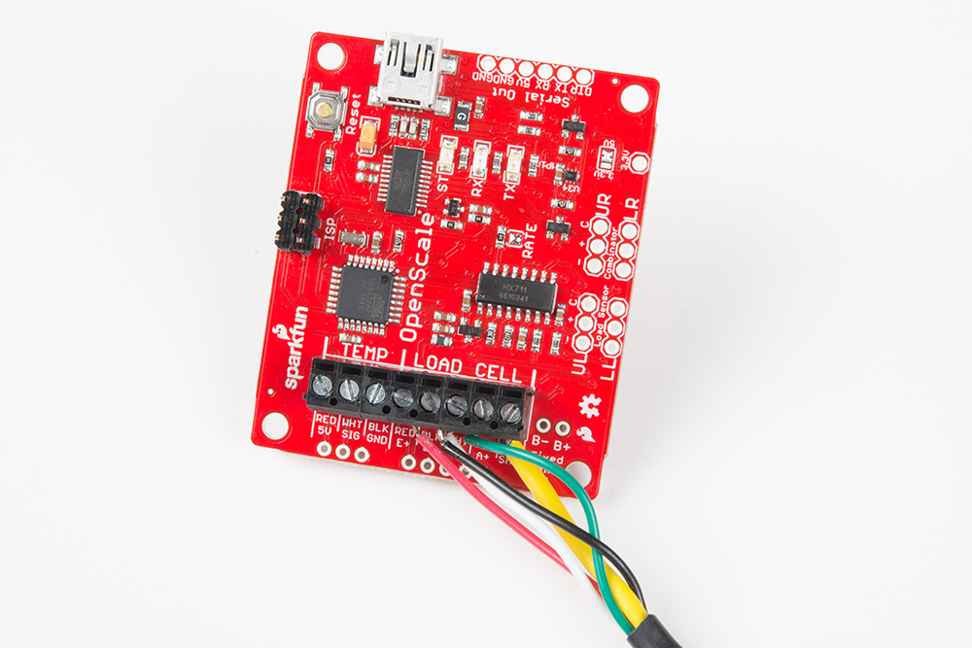
Sparkfun OpenScale
Built-In USB-to-Serial Converter
Load cell Combinator

Slide 6
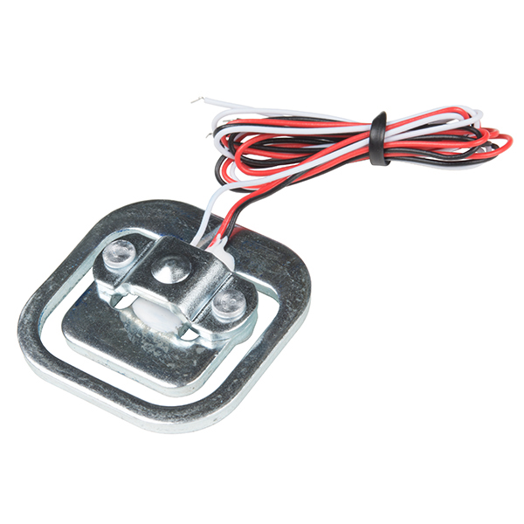
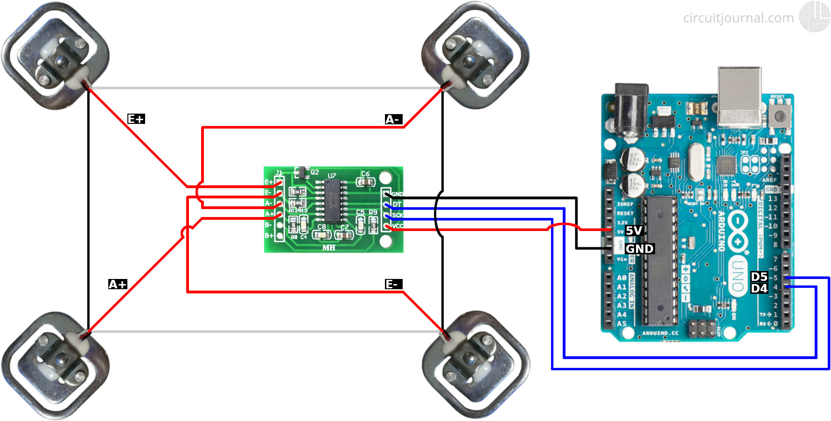
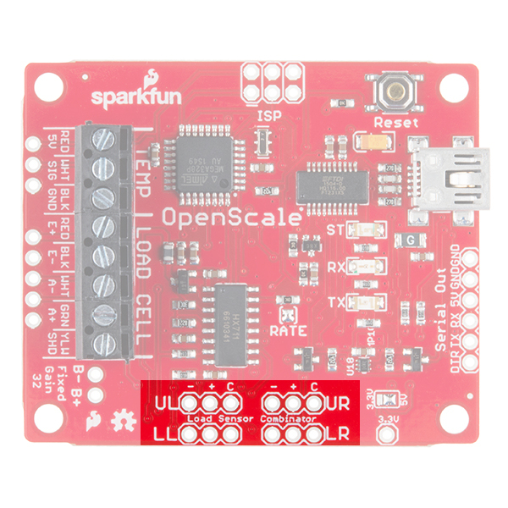
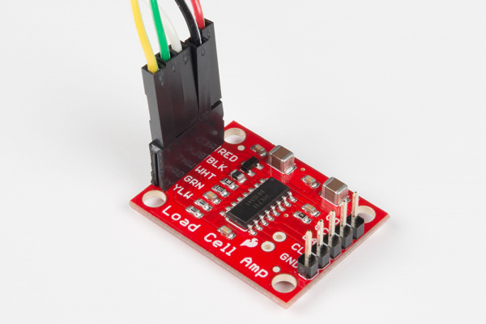
Search For A Load Cell
Found Four Load Cells
Wheatstone bridge When Using 4

Slide 7
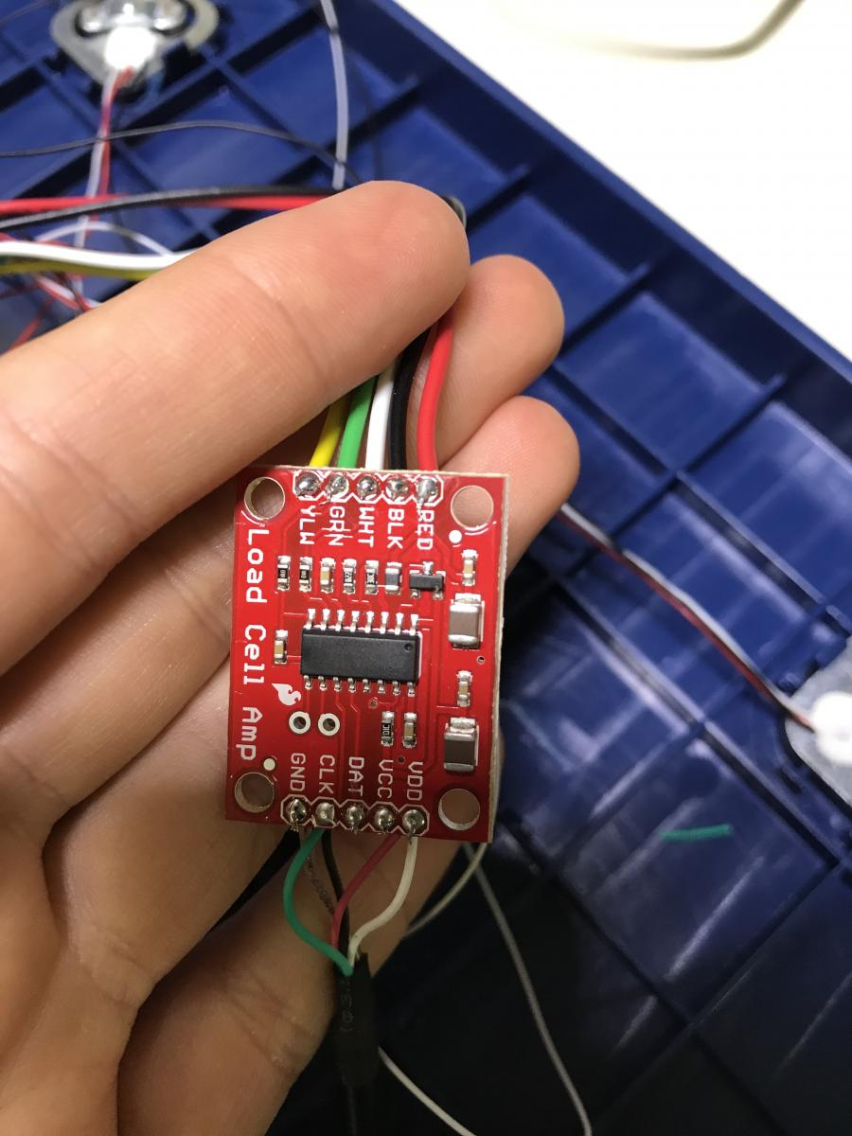
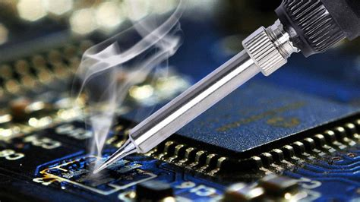
Soldering

Slide 8
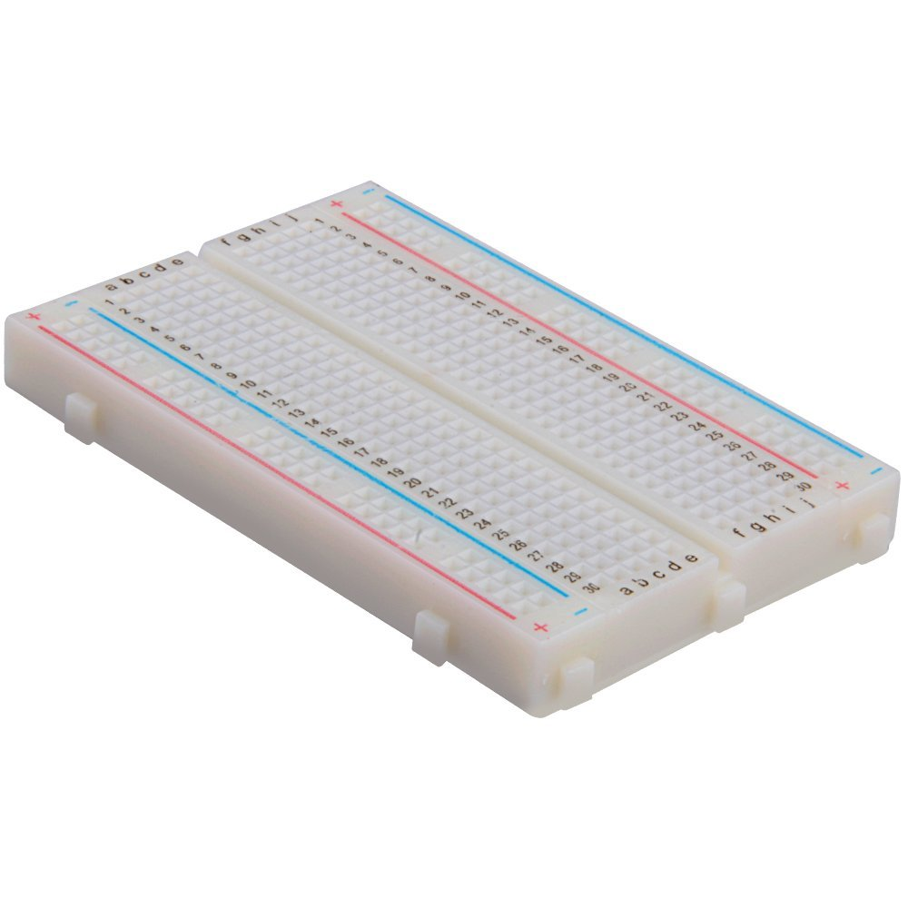
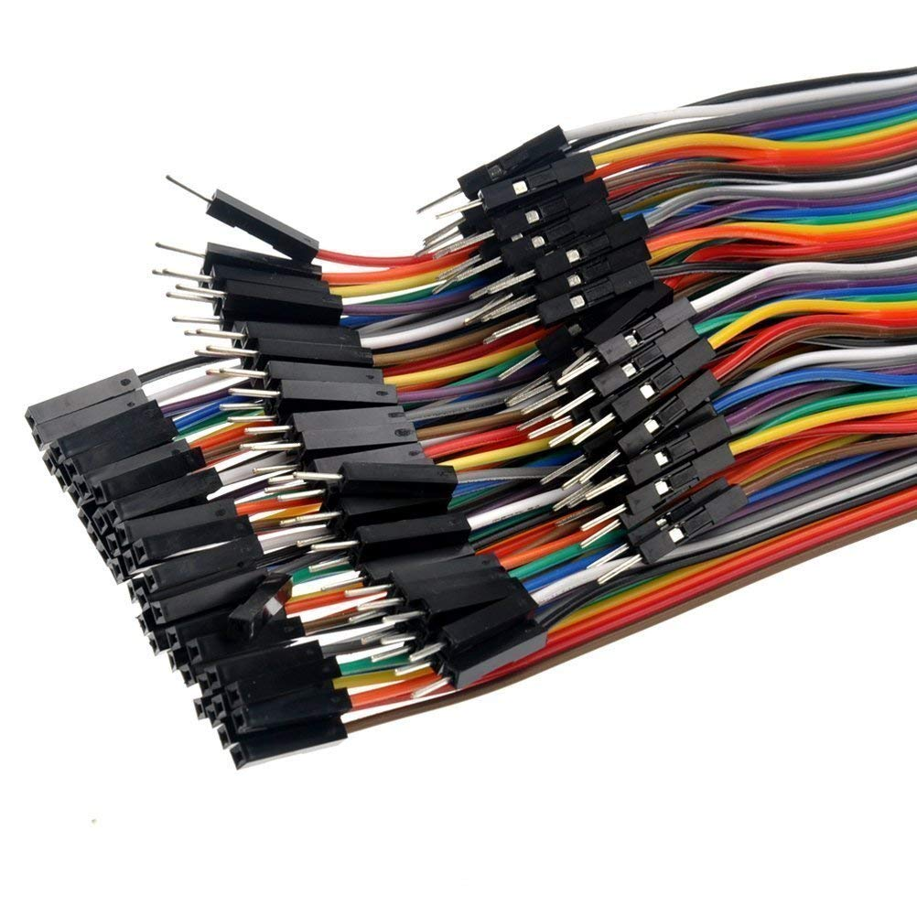
Acquired Materials

Slide 9
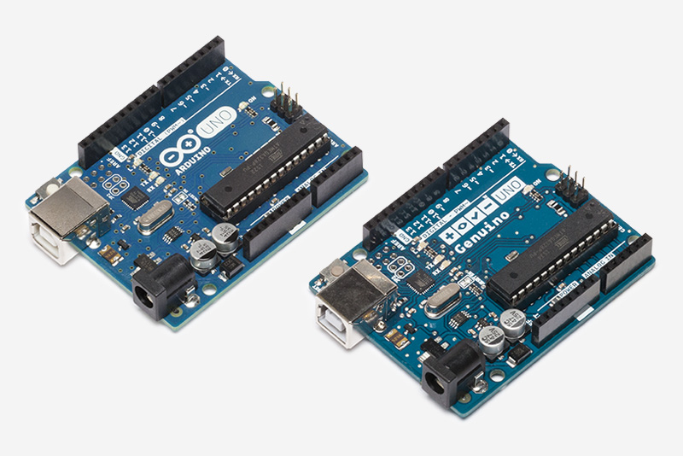
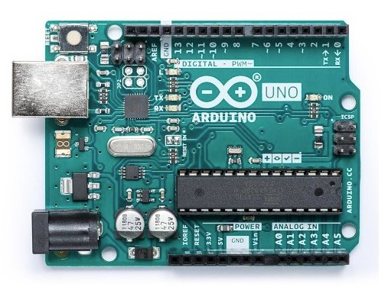
Arduino UNO

Slide 10
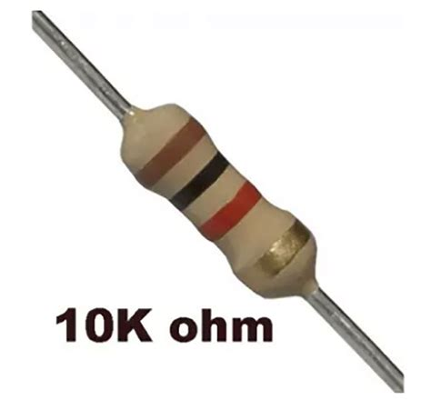
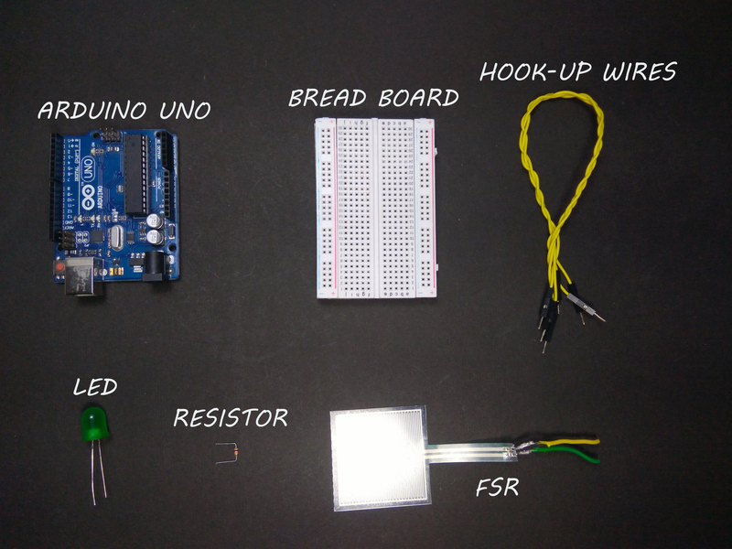
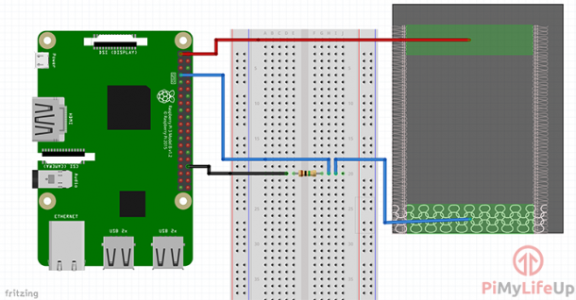
FSR Using Arduino Uno

Slide 11
DEMO

Slide 12
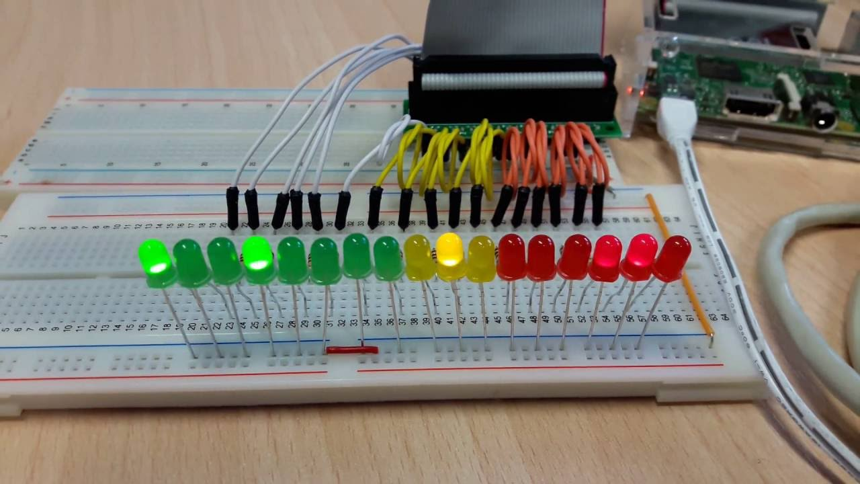
Future Direction
LED Lights
Implementing Load Cell
Wireless/Wifi
Arduino is an open source!

Slide 13
Conclusion
DIY Technology
Learning The Process

Slide 14
Resources
https://tutorials-raspberrypi.com/digital-raspberry-pi-scale-weight-sensor-hx711/
https://learn.sparkfun.com/tutorials/openscale-applications-and-hookup-guide
https://circuitjournal.com/50kg-load-cells-with-HX711#required-components
https://learn.adafruit.com/force-sensitive-resistor-fsr/overview

Slide 15
Group 36

